Slide 1
PSCS_49_Al-based tool for preliminary diagnosis of Dermatological manifestations
CSE7101- Capstone Project
Review-3
Batch Number: 2022
Roll Number | Student Name
20221CAI0037 20221CAI0048 20221CAI0008 | Armaan Khan Syed Basim Shaik Mahammed Saif
Under the Supervision of,
Dr./Mr./Ms./Prof.
Professor / Associate Professor / Assistant Professor
School of Computer Science and Engineering
Presidency University
Name of the Program: CAI-Computer Science & Engineering (Artificial Intelligence & Machine Learning)
Name of the HoD: Dr. Zafar Ali Khan N
Name of the Program Project Coordinator: Ms. Suma N G
Name of the School Project Coordinators: Dr. Sampath A K , Dr. Geetha A

Slide 2
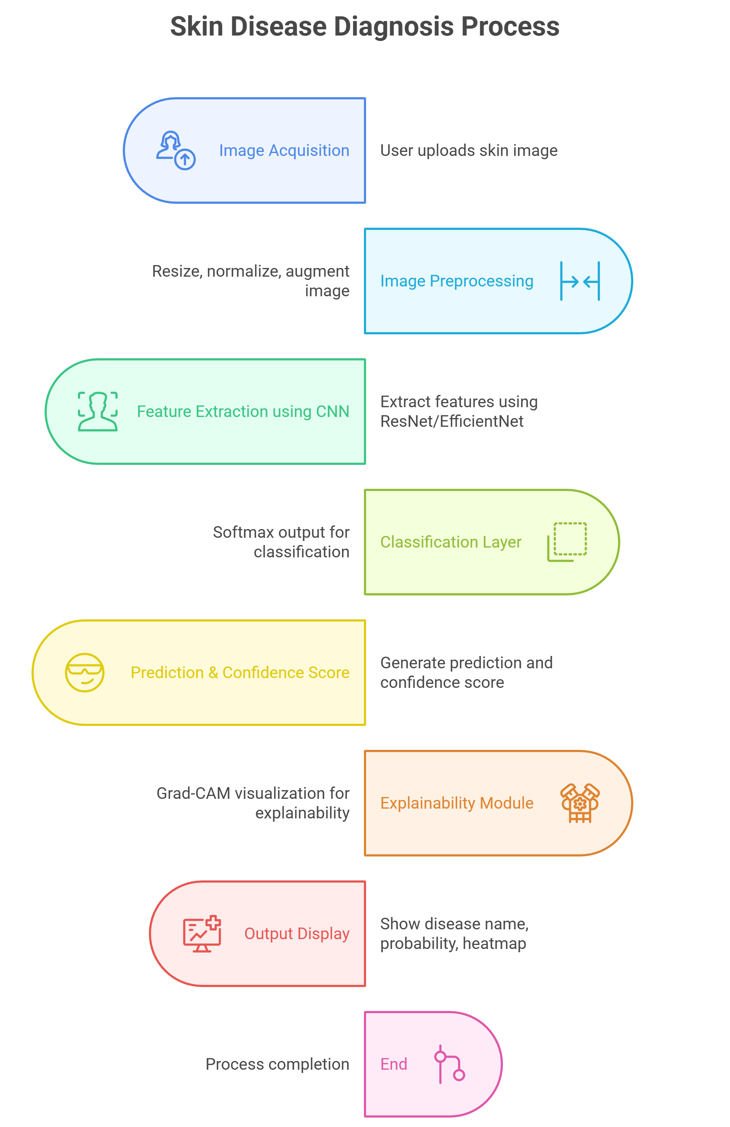
Architecture Diagram
Flowchart:

Slide 3
Proposed approach
The core goal of the given project is to design and implement an AI-based diagnostic support system that will be able to offer a preliminary evaluation of dermatological manifestations based on dermoscopic images and other key clinical metadata. The system is geared towards helping the healthcare professionals, more so those who are in a resource-constrained setting by providing prompt, precise and interpretable diagnostic information. The combination of state-of-art deep learning application with explainable AI and metadata integration are expected to increase the rates of early detection, a decrease in diagnostic waiting time and ease of access to dermatological services among rural and semi-urban areas of operation.

Slide 4
EfficientNetB4 Feature Extractor. The central part of the model is based on the EfficientNetB4 architecture that offers better performance in medical image classification because it offers balanced scaling of convolutional layers. The trained model, which was pretrained using ImageNet weights, produces fine lesion features which include pigment networks, asymmetry, vascularity, and edges. Metadata Processing Network The model includes the necessary patient metadata such as age, sex and anatomical location, all of which are clinically important in diagnosis. Age is normalized, and categorical variables (sex and location of the lesion) are one-hot encoded. These characteristics undergo fully connected layers to produce meaningful embeddings. Feature Fusion Layer An embedding of the image feature is combined with the metadata to produce a more comprehensive diagnostic representation. The hybridization enables the system to imitate the real-world dermatologist decision-making in which the diagnosis is made based not only on the visual feature of the patient but also on their context. Class Management with Class Skewing. The HAM10000 data is not balanced as it has some lesions that are not fully represented. Class weights are also computed and used in training the model to address the problem of biasness against classes that are of majority. Grad-CAM Explainability in AI.

Slide 5
Objectives
The objectives of this project will be designed to meet the behavioural, analytical, managerial, security and deployment needs of an AI-aided dermatological diagnostic system. These goals guarantee that the system is reliable, efficient in data processing, the system is trusted by the users, and can be deployed in the real field of healthcare. All the objectives can be measured and directly implemented in the system architecture and implementation.
Objective 1: As a part of designing and implementing a multimodal deep learning model, it is possible to analyse the dermoscopic image behaviour and extract clinically meaningful patterns. This goal is aimed at the behavioural component of the system and the possibility to detect and memorize the complex visual features of the skin lesion. The deep learning model should be able to detect pigment networks, asymmetry, lesion edges, vascular architecture, and texture differences that can be related to various dermatological diseases. The system is able to learnbehavioural cues such as observed by dermatologists by using EfficientNetB4 and other sophisticated convolutional operations, thereby guaranteeing the relevance and the accuracy of its diagnostics.

Slide 6
Objective 2: To create an analytical metadata fusion system that incorporates age, sex, and anatomical site with image-based characteristics in order to make a better diagnosis decision. The diagnostic process in dermatology cannot be entirely based on images, and the doctor usually uses demographics, and localization of the lesion to assess it correctly. This goal will provide the system with an analytical processing of metadata based on organized layers and fuses it with profound visual features via a fusion architecture. Clinical context integration enhances more dependable decision-making, and it reflects the actual diagnostic process, which enhances sensitivity and specificity between lesion types
Objective 3: To implement a model management workflow through systematic model where dataset is preprocessed, weights of classes are considered, performance is being monitored, and optimization is being done in an iterative manner to achieve a biased-free training. An effective diagnostic system must have a robust data and model behaviour that is internally managed. This goal presents an organized dataset balancing, normalization, augmentation, and partitioning workflow. The model is fair and it reduces bias in the classes of majority, which is achieved through class-weighting schemes and continuous training observation. This is to make sure that minor forms of lesions like dermatofibroma or vascular lesions are well reflected in the training and help in achieving a balanced assessment.

Slide 7


